Slide 1

Kennissessie Python unleashed
Door: Maarten van Hulzen Antoon Uijtdehaag Agenda:
Python in het ArcGIS Platform
Bouwprojectje: The Internet of Things (IoT) - ArcGIS

Slide 2
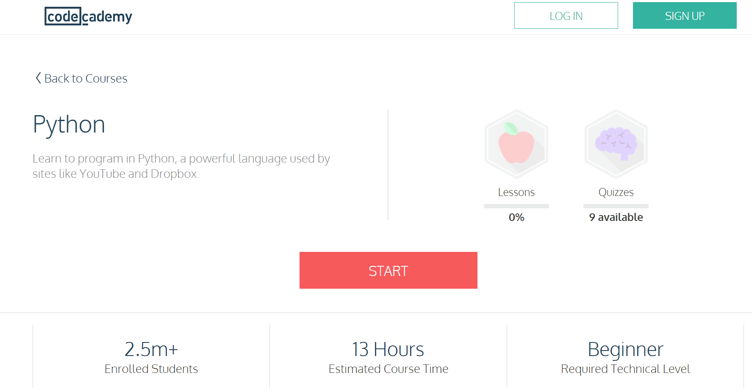
(Tuple)
Verschil? [Lists]

Slide 3
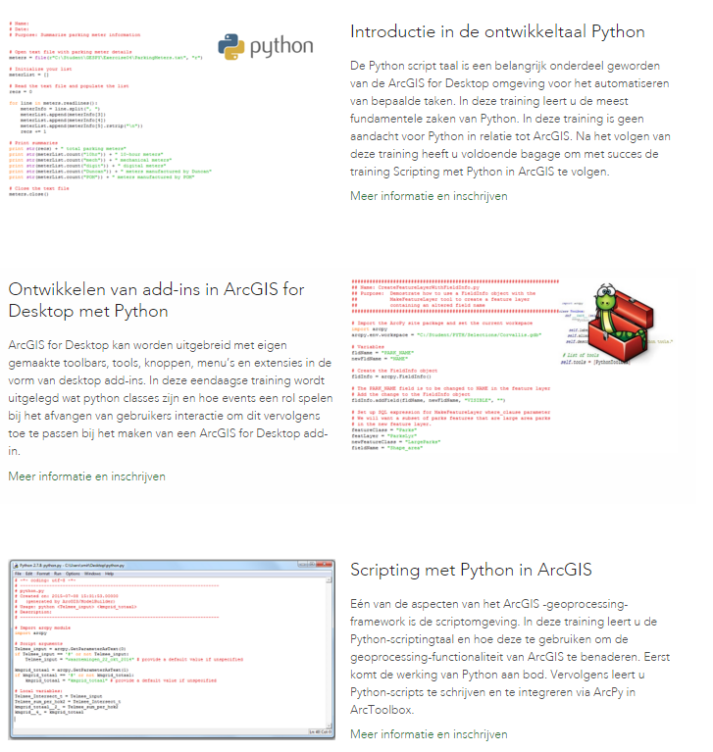


Slide 4
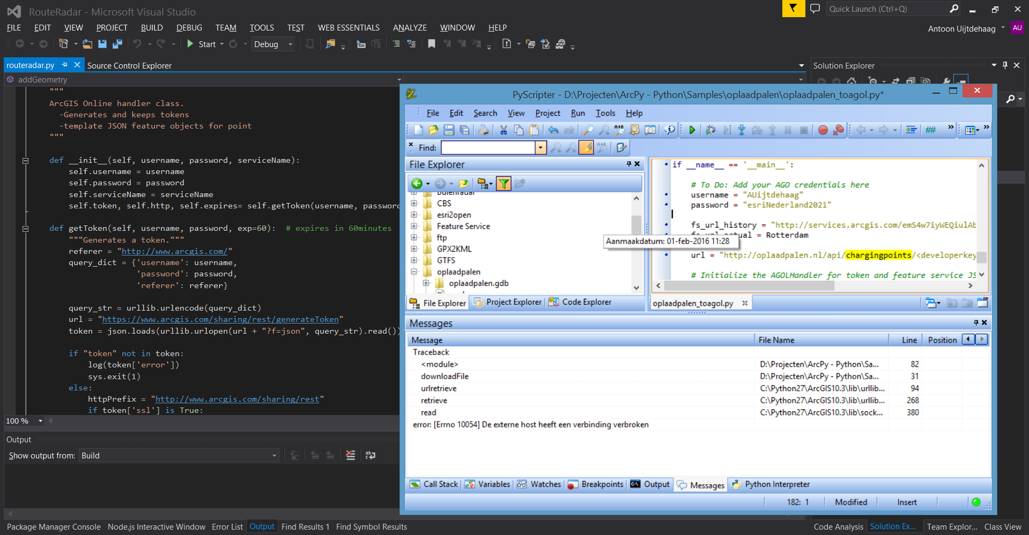

Slide 5

Tips & Tricks Python in het ArcGIS Platform
Simon Law: https://flic.kr/p/wcDZ

Slide 6
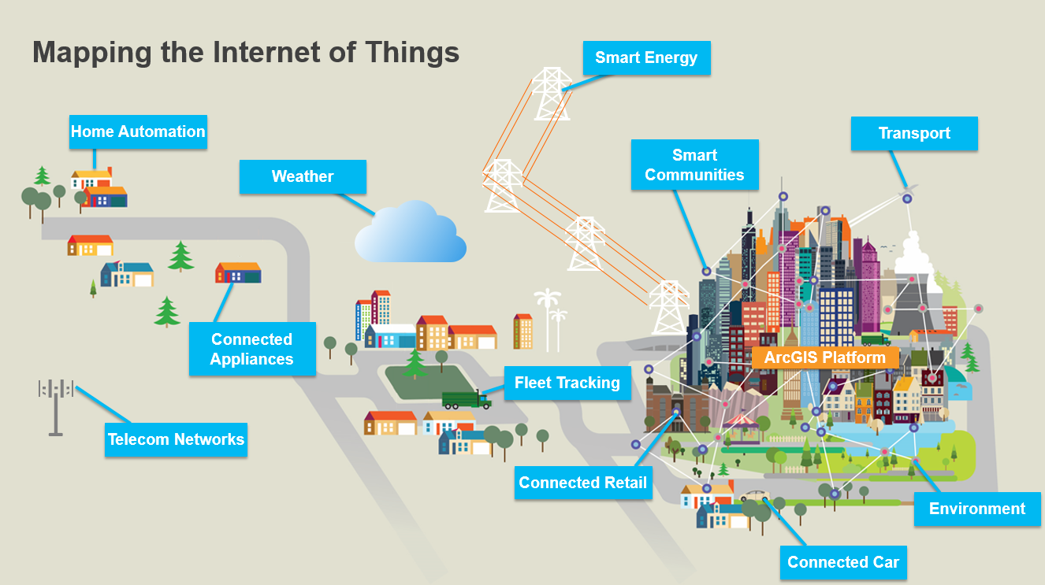

Notes:
http://telecomrc.maps.arcgis.com/apps/MapJournal/?appid=895bd00c9e7c4521b21e94da5d4748fc

Slide 7
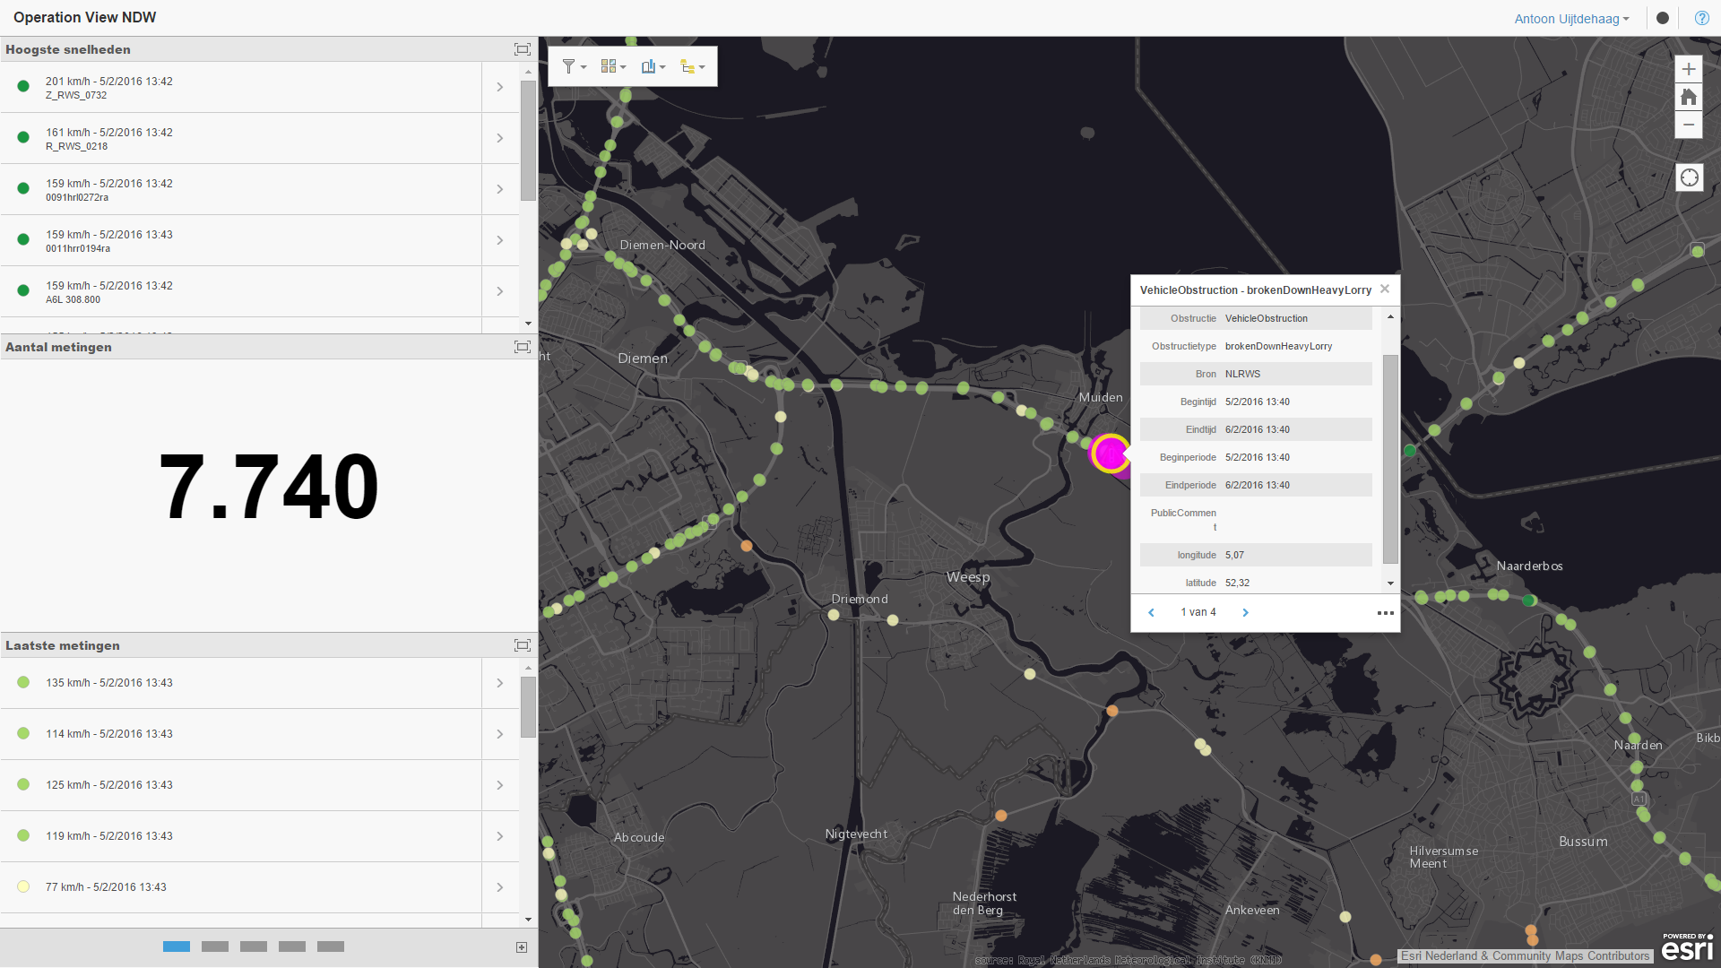
Notes:
http://esrinederland.maps.arcgis.com/apps/dashboard/index.html#/fc0c1d2bd9af4e2285a483ce80a90253

Slide 8

GTFS Realtime
Daniel Mennerich https://flic.kr/p/hcXKNo
Notes:
https://github.com/Esri/public-transit-tools
http://gtfs.openov.nl/gtfs-rt/
https://developers.google.com/transit/gtfs-realtime/

